Slide 1
TECH4EFFECT – KNOWLEDGE AND TECHNOLOGIES FOR EFFECTIVE WOOD PROCUREMENT SILVISMART The forestry efficiency portal

Slide 2
What is SILVISMART?
SILVISMART is a ‘one-stop shop’ for your harvesting and forest data: Data captured by machines is automatically transferred to our database, analysed and presented in reports.
SILVISMART

Slide 3
SILVISMART services: From machine-captured data to business intelligence
Automatic transfer of data from machines to storage
Standardised across machine types
Storage and organisation of data
Central, highly secure and long term
Visualization and analysis of data
Automatic reporting of data
Daily production reports, custom reports
Benchmarking
Efficiency analysis and guidance on improving your operations

Slide 4
Data privacy and safety
Secure, encrypted data storage on Amazon cloud
Chose how long you want your data to be stored
If you opt out, you take ALL your data with you
Access to data is tightly controlled – different types of user profile get access only to specific datasets

Slide 5
Who is it for and why use SILVISMART?
Machine owner (contractor)
Automated data transfer and backup, standard reports
Data for accounting and invoicing
Benchmark information – increase efficiency
Forest owner / manager / consultant
Standard reports, visualisation and localization of data, statistics
Monitoring of operations, information for (logistics) planning
Machine operator
Automated data transfer and backup, standard reports
R&D (scientist) / forest certification
Reliable, transparent data
Transparent & secure
Learn from reports:
save time & money

Slide 6
Interface: My fleet
User: machine owner with multiple machines (contractor)
Overview of all your machines, e.g.
Fleet information (brand, model, …)
Harvester productivity (trees, volume per day)
Calibration
Forwarder productivity
Standardised format for different machine brands.
How do your machines compare with each other?
How well are your machines matching a task?

Slide 7
Interface: My operation
User: machine owner with multiple machines (contractor)
Information on a single stand:
Object summary (assortments distribution per species)
Forwarder production (loads per day)
Object summary map (geographic distribution)
Get data to invoice your clients.
How much was produced in this stand?
Standardised format for different machine brands.

Slide 8
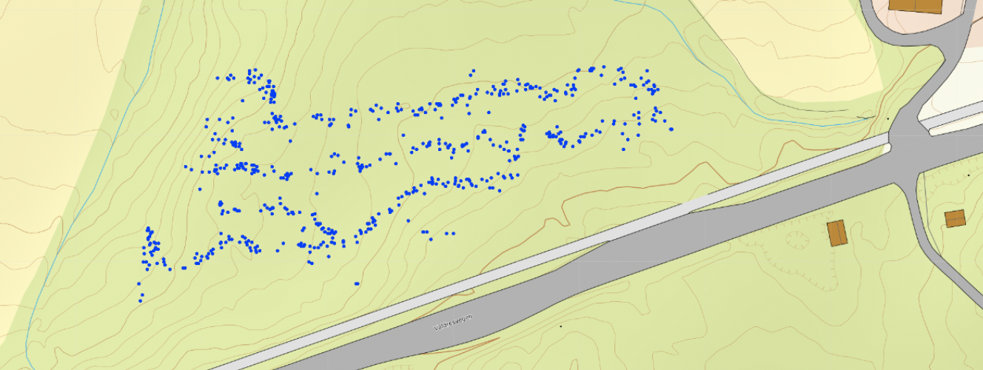
Interface: My stand (my forest)
User: forest manager or owner
Information on a single stand (or forest)
Assortments distribution for each tree species
Object summary map (geographic distribution and localization)
Stem map
Maps and summaries of volumes, species distributions and assortments.
Where have the machines been?
How much was produced in this stand (forest)?

Slide 9
My files & access
User: available to all users
Setup access email and access to data
For administration and downloading: raw data and processed data
Add information to a stand: operation type, terrain info, stand polygon
Upload machine files
Download files

Slide 10
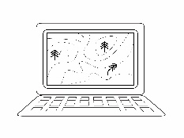
Data transfer
The machines collect data in StanForD files
Connect a small box to your onboard computer and install an app on your smartphone for automatic transfer
Send data files manually via e-mail
Use your existing fleet-management system to send StandForD files
Data is stored in the centralised SILVISMART database
Greenbox

Slide 11
You can participate in SILVISMART!
Send an e-mail to your national contact to receive your login
For Norway Rasmus Astrup (NIBIO):
rasmus.astrup(a)nibio.no
For Denmark Niels Strange (UCPH):
Nst(a)ifro.ku.dk
For Germany Hans-Ulrich Dietz (KWF):
dietz(at)kwf-online.de
For Austria Thomas Holzfeind (BOKU):
thomas.holzfeind(at)boku.ac.at
For Italy Giulio Cosola (CONAIBO):
progetti(at)conaibo.com
For all other countries: rasmus.astrup(at)nibio.no
For South Africa Simon Ackerman (Stellenbosch Univ.): ackerman(at)sun.ac.za

Slide 12
Consortium
Research institutes and universities
Owner associations and forest contractors
Machine manufacturers & SMEs
State forests

Slide 13
Acknowledgements
The project and research presented here has received funding from the Bio Based Industries Joint Undertaking under the European Union’s Horizon 2020 research and innovation programme under grant agreement No. 720757.

Slide 14
Thank you for your attention …
… and find us on
@TECH4EFFECT
www.tech4effect.eu
www.silvismart.eu
© Images: Shutterstock / RTDS / NIBIO

